Slide 1

Welcome to COMP2001 Information Management and Retrieval
Dr Shirley Atkinson

Slide 2
Architecture layers
Working on these ones now
Front-end frameworks for interface layer
Using Razor
Consider secure coding in middle layer
Presentation layer
Business layer
Data layer

Slide 3
Designing front end
Need to give some thought as to user experience
Storyboarding/wireframing/sitemapping – all approaches to developing a clear idea of what your user is going to see and how they are going to interact with it
Important to plan
Not the remit of this module to go into design aesthetics
We are not artists but creators of software applications
Use templates if being artistic is not your thing
Use templates any way as they help get there quicker

Slide 4
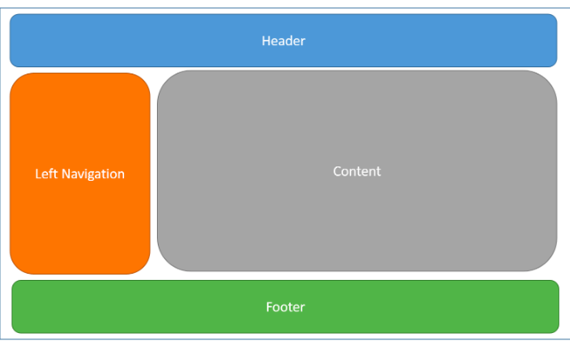
Standard layout

Slide 5
Bootstrap
A framework providing grid layout functionality
Grid layouts having been in publishing for years
Rows of floating elements
Each element contains a column
Marked by <div> tag
Class names used to denote what they are
Unit 5 linked via CDN
An advantage is users may have already visited a site that required it
So it’s in their cache
But can download - https://getbootstrap.com/

Slide 6
Bootstrap : Important points
Needs containers to work
These wrap and centre the web page and specify width for layout
Container holds grid rows and columns
<div class=“container”>
Each row contains 12 columns
Only the columns can contain content

Slide 7
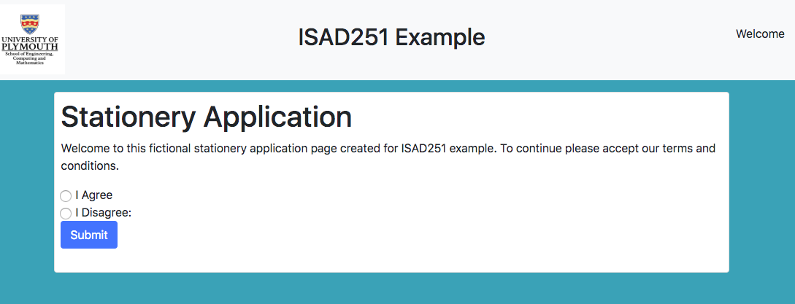
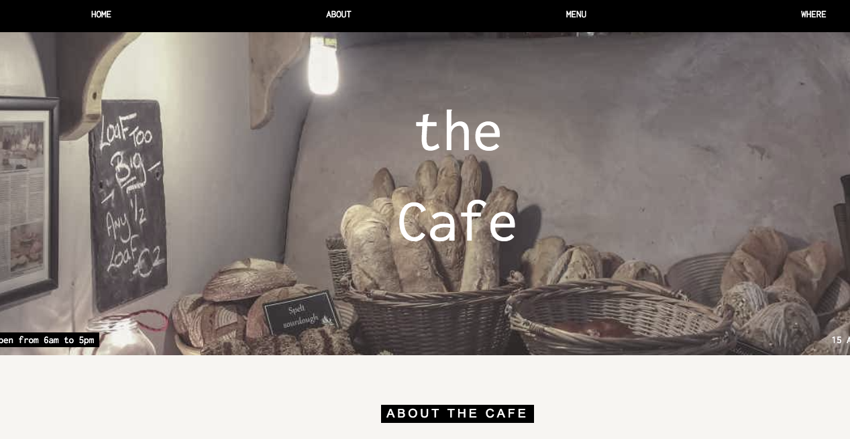
Refactoring front end
Take unit 5 index.php
Imagine I want to refactor, I’m bored with it
I want it just to go direct to the products
Take a look at W3.css templates and choose one to apply
Notes:
Ensure the head part has all the links to the appropriate stylesheets

Slide 8
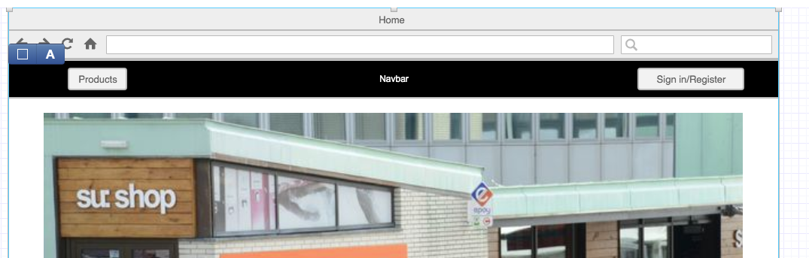
Home page
Hero image
Nav Bar

Slide 9
Copy header info over into header.php
Adjust column class from 3 to 4 (grid of 12 columns but I only want 3 items)
Set a new background image
Put the image in assets/img/
Create sections for products and about
Put header section in index.php
Comment out background colour in footer
Change colour of text to black in footer
How….

Slide 10


Slide 11
Visual studio 2019
Starter templates
All are starting points into the same functionality
Sometimes is best to start with empty and add in what you need
ASP.NET Core 2.2 uses Bootstrap 4 by default
All built in no need to install
Just use

Slide 12
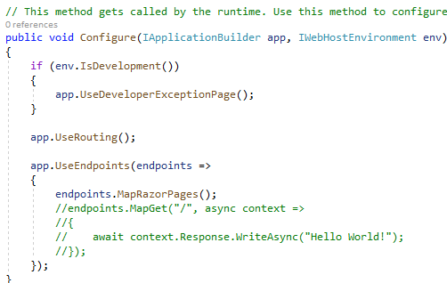
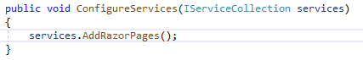
Visual Studio : Empty Project
Startup.cs
Configure method
ConfigureServices method
Requires pages to be in default folder called “Pages”
Startup.cs
Certain aspects not added in as standard
Eg: Adding Razor pages

Slide 13
ASP.NET MVC
When creating own layout file
Add to Views -> Shared
Select Razor Layout
Store images inside the wwwroot folder – recommend you create another folder inside called img
Make sure you have
﻿app.UseStaticFiles();
In the startup.cs file so that it automatically looks in wwwroot

Slide 14
ASP.NET Images
In the forthcoming exercise there is adjustment between using W3 CSS Template in PHP and the same type of template in ASP.NET
Issues with display of the background image
Plenty of discussions on forums
Still not resolved
Work around – place image in own container directly into index page

Slide 15
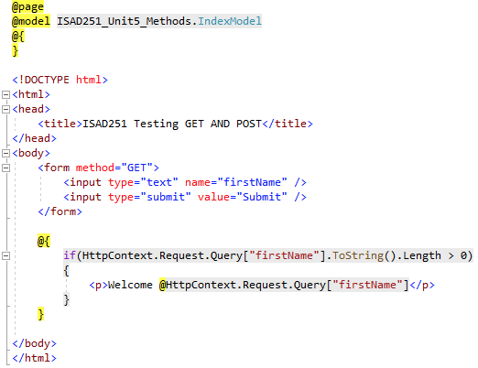
ASP.NET R(Bl)azor pages
A ”View” engine
Allows mixture of client-side mark-up with server-side code
Same principle as using PHP
Blocks of code are wrapped in @{ }
Variables to output prefixed by @
Being rebranded to Blazor
Notes:
We will build on this bit by bit as we go along

Slide 16
Razor Expressions
Razor must not be used for business logic nor to manipulate the model objects
Keep your separation of concerns
Controller Action method passes a view model object to the view
It does not pass formatted data to the view
The view uses the view model object to present the content
It does not change any aspect of the view model object

Slide 17
View Model
Syntax at top of cshtml file = @model Product
Can use this to display information
<p>Product Name : @Model.Name</p>
<p>Product Price : @Model.Price</p>
Can format the data – but not manipulate it.
Processing data – includes selecting data objects to display
Is the responsibility of the controller
Controller calls on model to retrieve and modify data

Slide 18
ViewBag
Controller
Public ViewResult Index()
{ Product myProduct …
ViewBag.StockLevel = 2;
return View(myProduct_);
}
ViewBag property returns a dynamic object which can be used to define arbitrary values
Assign the values as you go along
It will not show any auto-complete in the IDE
Assign a value in the controller
And then access it in the view
View
<p>Stock Level : @ViewBag.StockLevel</p>

Slide 19
Attribute values
Can use Razor to set value of HTML element attributes
<div data-productid=@Model.ProductID” >
<p>Product Name : @Model.ProductName</p>

Slide 20
Razor conditional statements
Razor is able to process conditional statements
Can tailor view based on values in view data
@: prevents razor interpreting this as a C# statement and makes it output the text
@switch (ViewBag.StockLevel)
{
case 0 :
@:Out of stock;
break;
case 1 :
…
case 3:
<b>Low Stock (@ViewBag.StockLevel)</b>
break;
default :
@: @ViewBag.StockLevel in Stock
break;

Slide 21
Razor : if…
@if (ViewBag.StockLevel == 0
{
@:Out of Stock
}
else
{
@: @ViewBag.StockLevel in Stock
}

Slide 22
Razor : arrays
Used when a collection of objects is passed to a view from the controller
@foreach enumerates contents of model
<table>
<tbody>
@foreach (Product p in Model)
<tr>
<td>@p.Name</td>
<td>@p.Price</td>
</tr>
</tbody>
</table>

Slide 23
Security
Never trust user input
Sanitise it early – eg make it safe early on
SQL Injection
Use prepared statements
XSS – Cross Site Scripting
Proper password protection – DO NOT STORE in plain text
Error handling
https://www.owasp.org/index.php/Main_Page
OWASP top ten

Slide 24
Sanitising inputs
Validation
Removal of harmful data
Eg <script> tags
Quotes
Escaping
Render potential harmful data as harmless
Eg: <script> becomes &lt;script&gt;

Slide 25
SQL Injection
Use prepared statements with parameterized queries
Use stored procedures
Use whitelist validation
Escape all user supplied input
Consider enforcing least privilege
Consider whitelist input validation

Slide 26
Prepared statements outline
String sql = SELECT * FROM ".$tablename
Connection.ExecuteQuery(sql)
UNSAFE
String param = getParam(value)
String sql = SELECT * FROM ?
Param.setString(1, param)
connection.executeQuery(sql)

Slide 27
Stored proc vs sql with parameters
SQL for stored procedure is defined and stored in database. It is called from the application
SQL with parameters is in the business layer and is the application passing into the database
Developers do not usually generate SQL inside stored procedures
Nothing unknown is therefore encouraged

Slide 28
Whitelist input validation
String tableName
Switch(inputParameter)
Case “customers” : tableName = “Customers”
Break;
Case “products” : tableName = “products”
…
Default : throw exception
In our example we passed in a POST variable with a table name
What if that was a user style input
We might use switch statement to map from the input to the established table name

Slide 29
Least Privilege
Can create a user for the database that is used by the application
Use roles to restrict the operations to a sub-set of what is available
Only grant roles that are required
Requires database administrator privileges

Slide 30
Activity
I will randomly allocate you to breakout rooms
Remember to introduce yourselves
Someone will need to feedback
Jot down a list of what security features you intend to have in your application
What is in your data layer?
What will you put into your code layer?
10

Slide 31
PHP : Classes
Will be using classes to represent how to create repository pattern
Rather than just looking at what ASP.NET creates for you
Classes are the same type of construct as you have met in other languages
Do not have an accessor (eg: private/public)
Have properties
Have methods
Uses $this-> keyword inside methods

Slide 32
PHP Classes
__construct function automatically runs when you create a new instance of a class
Allows you to initialize the objects properties
CONST is publicly accessible
So we will change our values

Slide 33
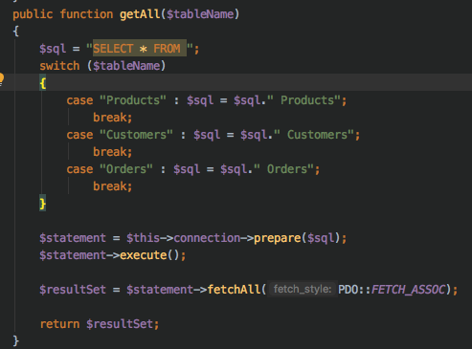
Refactoring getAll
Previous example appended incoming POST value into SQL statement
Not good practice
Apply whitelisting principles
Use switch

Slide 34

University of Plymouth
Advancing knowledge, transforming lives

